Slide 1
NLP on “The Stormlight Archive”
Nick Kinnaird
2/26/21
Winter 2021 Cohort

Slide 2
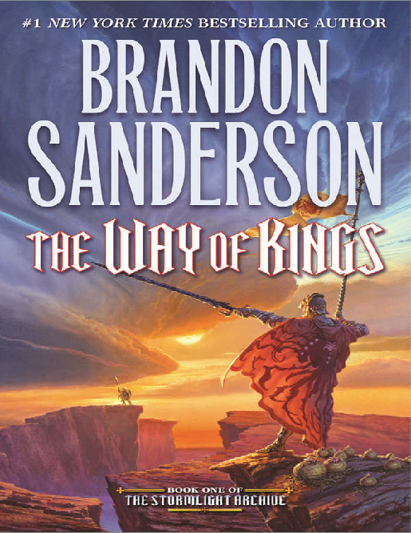
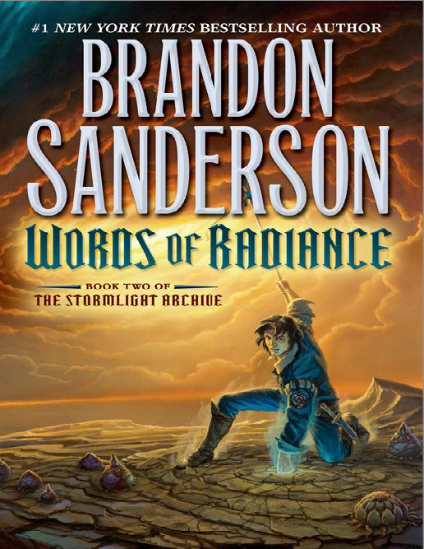
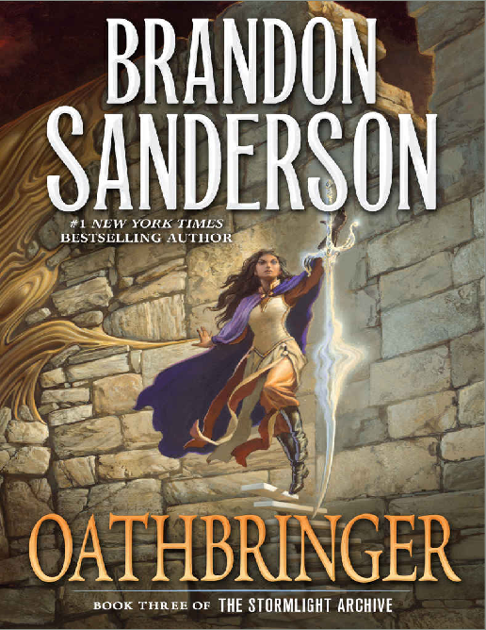
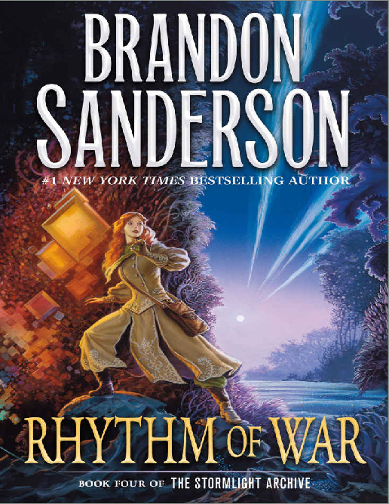
On-going fantasy series by Brandon Sanderson
4 books out so far
400+ chapters, 5000+ pages
Nothing I show will be a major spoiler, but in case your interested in reading these books, you might want to avoid paying too close attention

Slide 3
Processing
Analyzed the text in both chapter-level documents and page-level documents
Did kMeans clustering, NMF, and LDA topic modeling
NMF performed the best without much tuning so the results I will show are for that

Slide 4
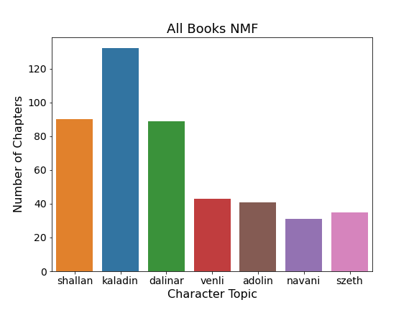
Main topics came out to be the main characters themselves
Names were the top weighted word in each topic
I tuned the number of topics to 7

Slide 5
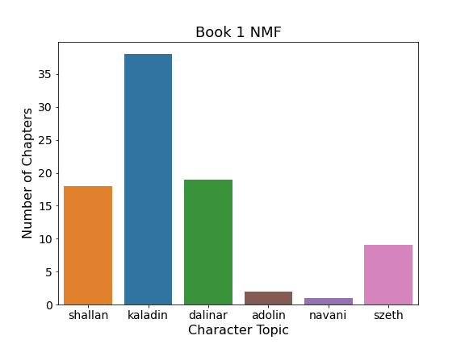
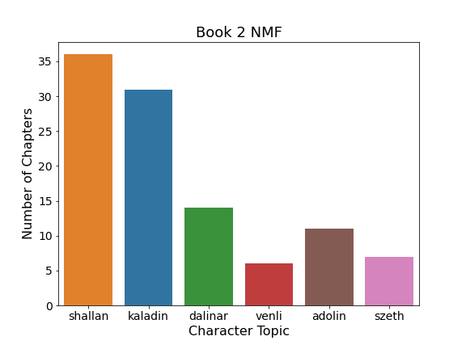
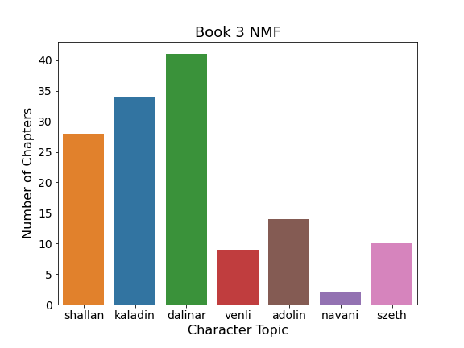
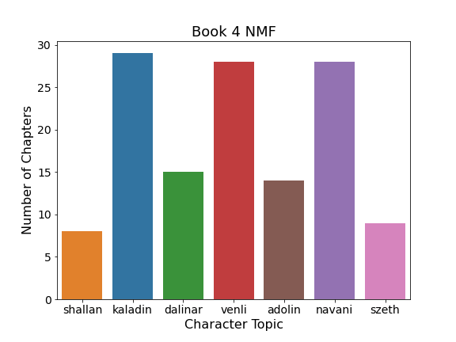

Slide 6
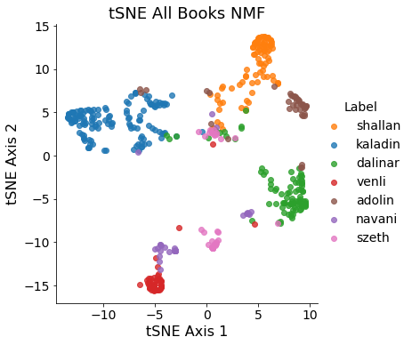
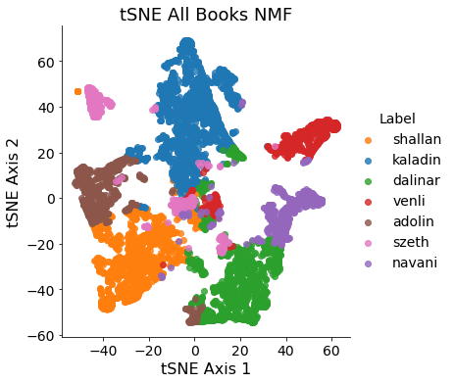
Made tSNE plots from NMF topic vectors for each document:
By Chapter
By Page

Slide 7
Topic modeling for characters
I then took each specific character, and did more topic modeling on the chapters/pages labeled for that character
This time I added character names to the stop words in order to find more thematic topics
Just going to show results for one character, rest of the plots can be found in the appendix

Slide 8
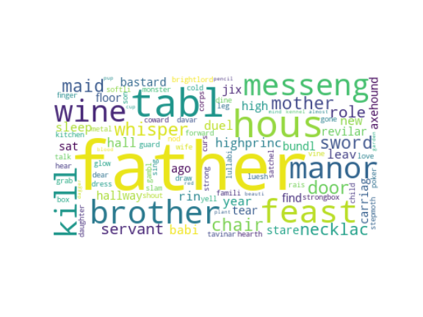
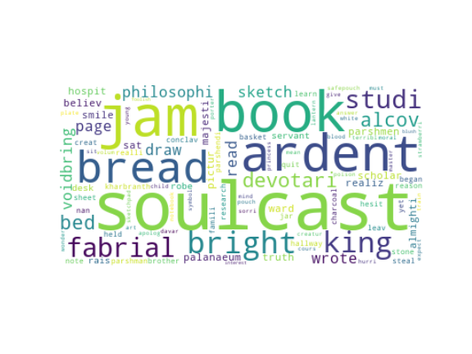
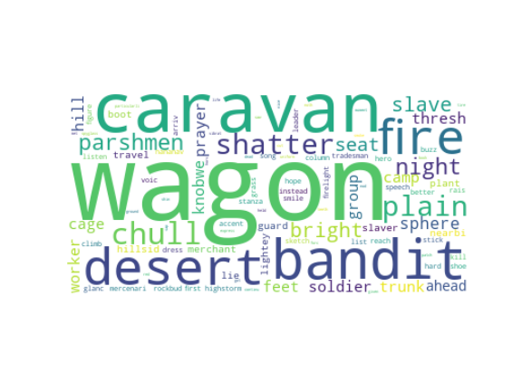
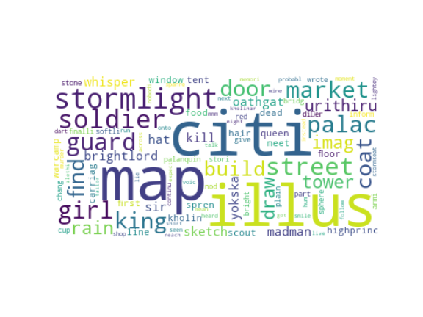
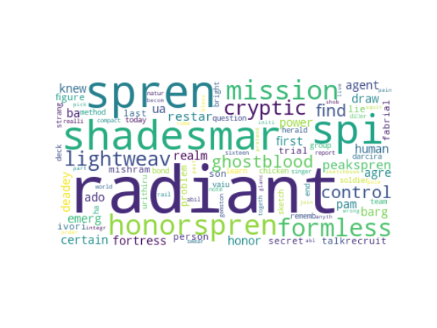
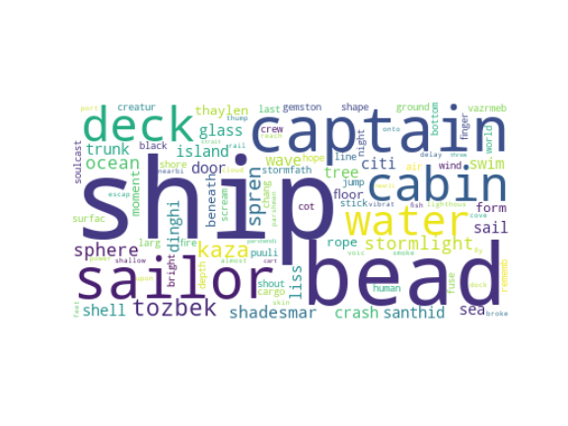
Sub-topic word clouds for chapter-level documents for Shallan

Slide 9
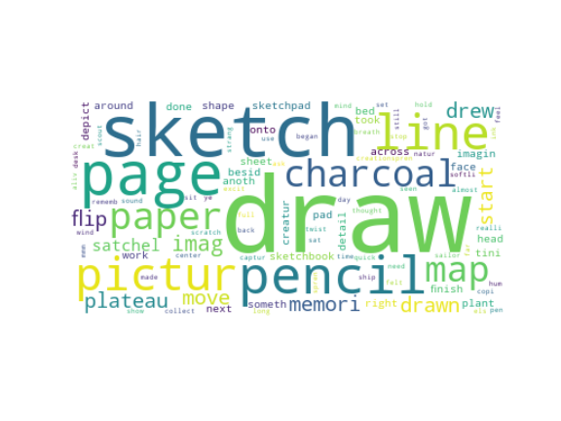
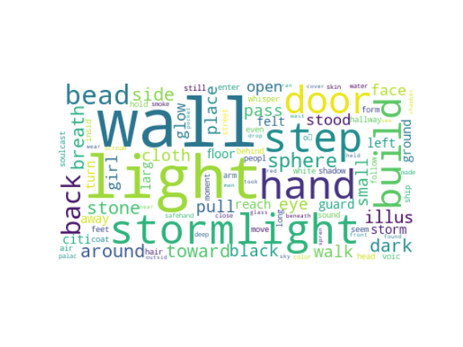
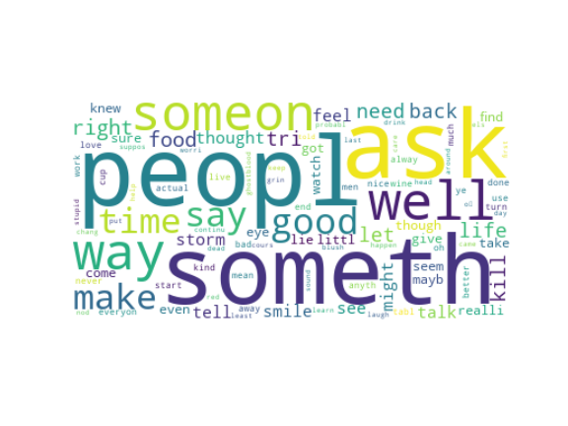
Sub-topic word clouds for page-level documents
Got some of the same topics, but also some new ones which are less plot-related

Slide 10
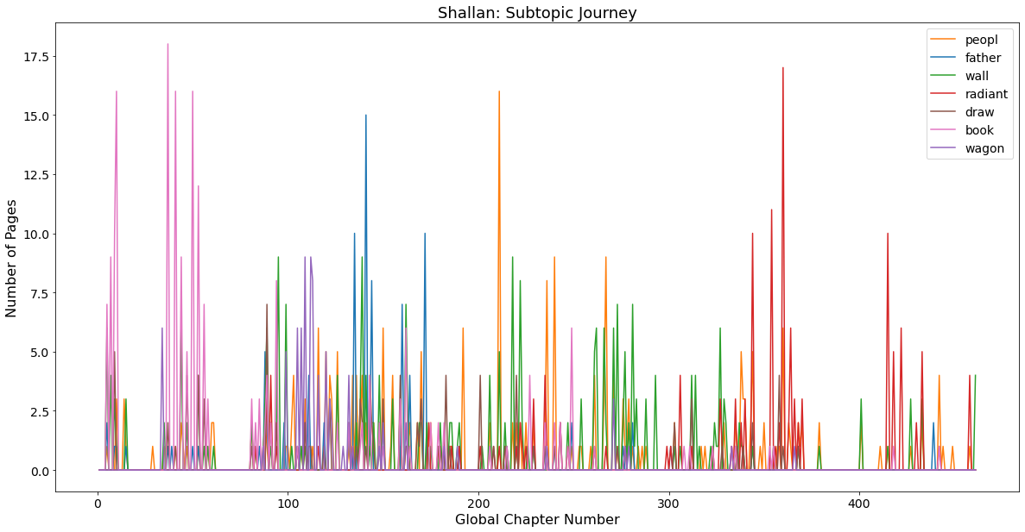
Shallan’s journey via her subtopics:
(top word of sub-topic)

Slide 11
Future work
My topic modeling ultimately converged on mostly “physical” or “plot” things rather than concepts like morals, loss, honor, faith, etc. which the books go into a lot
Pare down the text to paragraph-level or smaller documents to get at more interesting topics
Did sentiment analysis which didn’t work very well, so that might help with that as well
Focus more specifically on one character to really dive deep

Slide 12
Appendix

Slide 13
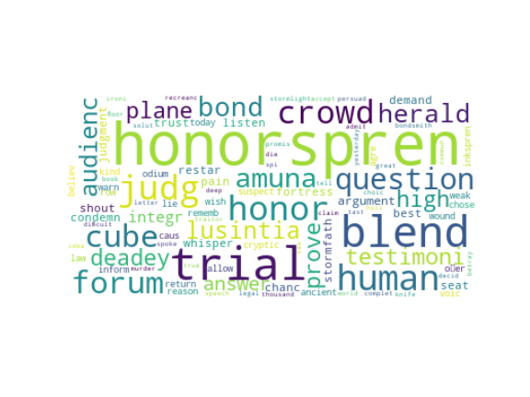
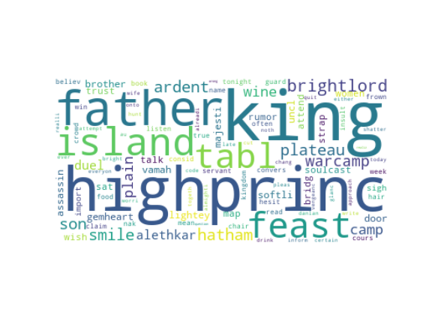
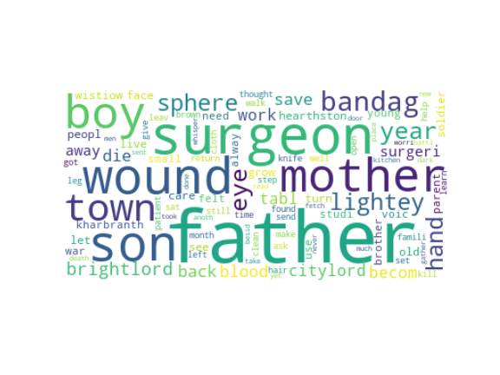
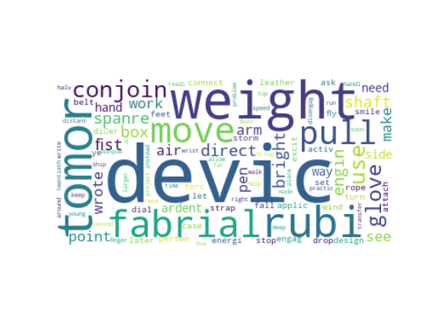
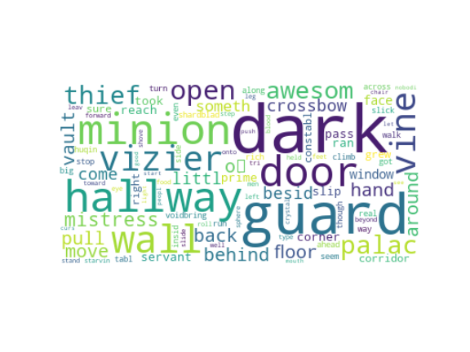
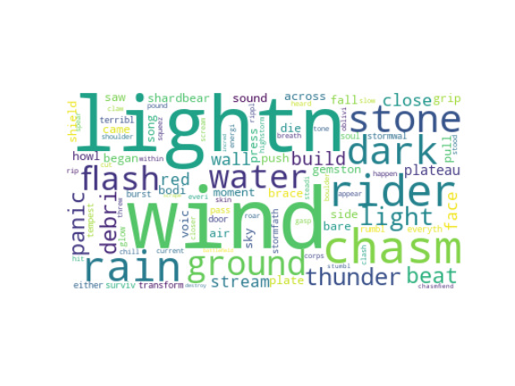
A few other word clouds for the other characters:
Adolin
Dalinar
Kaladin
Navani
Sezth
Venli

Slide 14
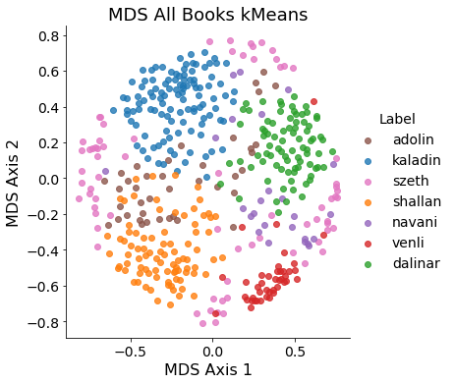
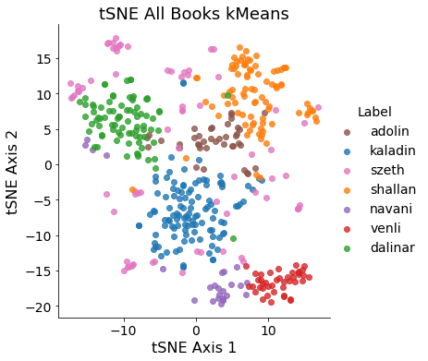
Dimensionality reduction plots with kMeans results

Slide 15
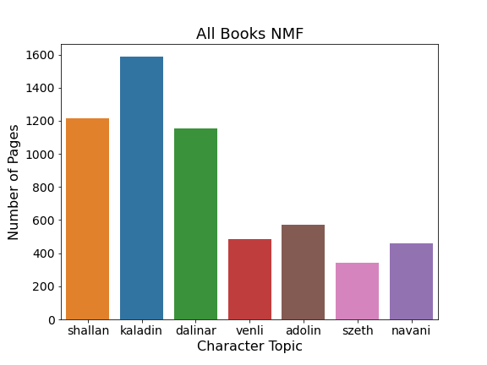

Slide 16
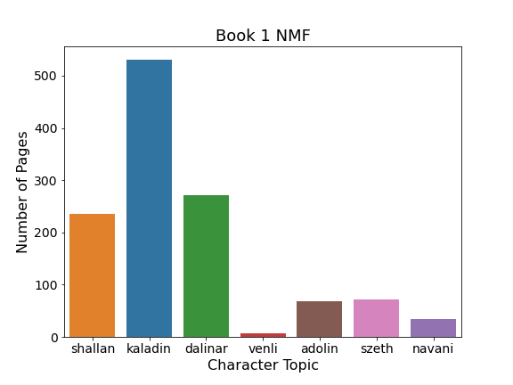
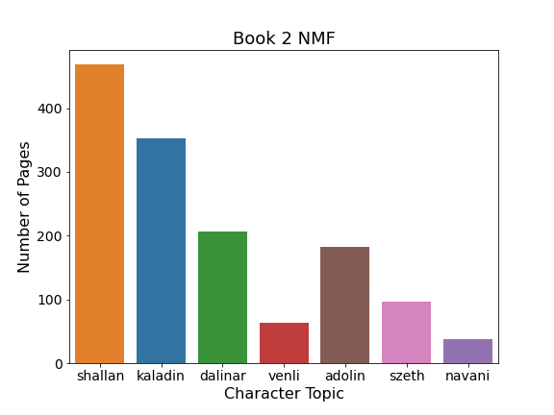
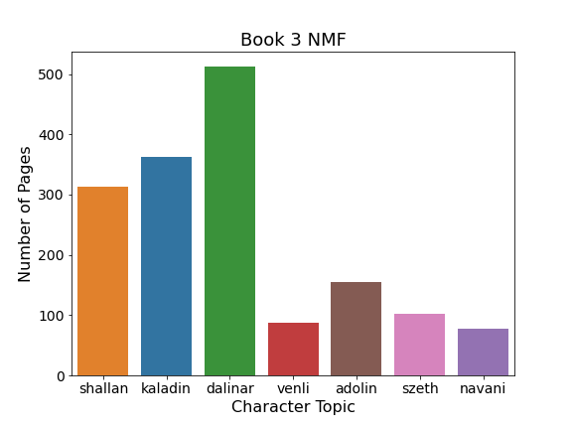
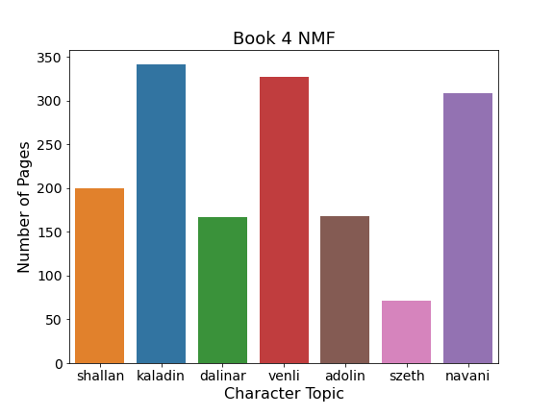
Topics for pages

Slide 17
Shallan

Slide 18
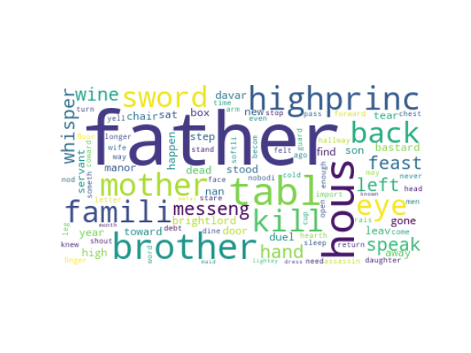
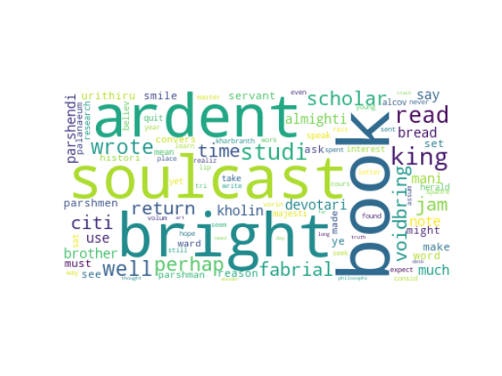
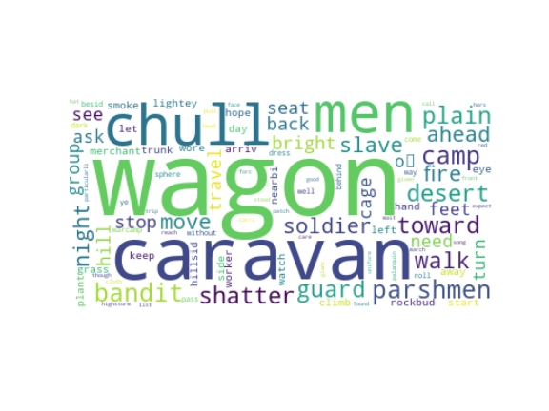
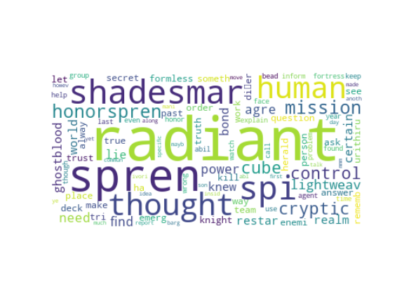
Page
Word Clouds

Slide 19
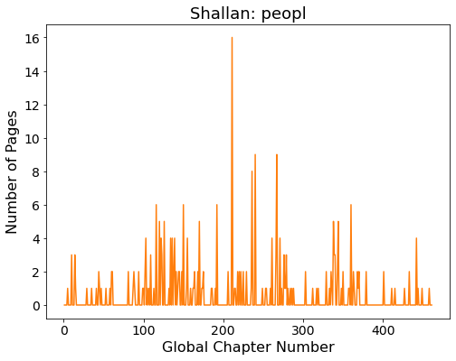
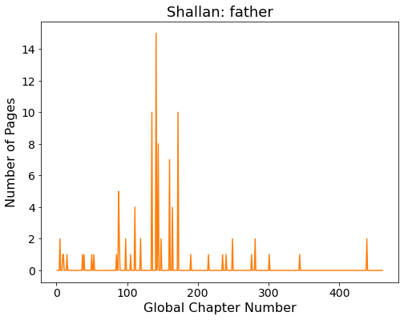
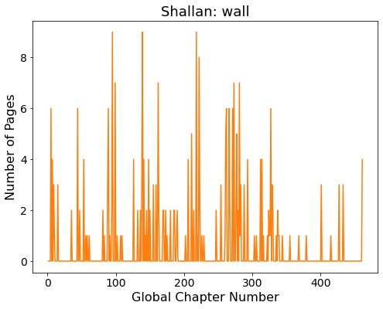
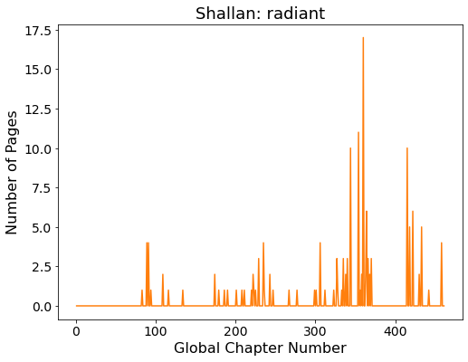
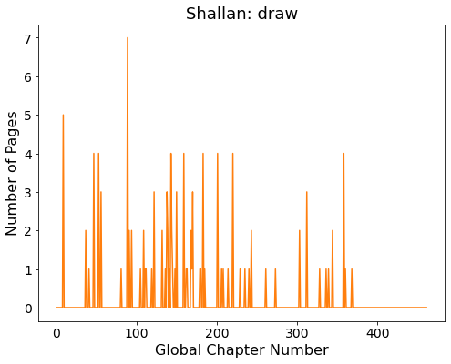
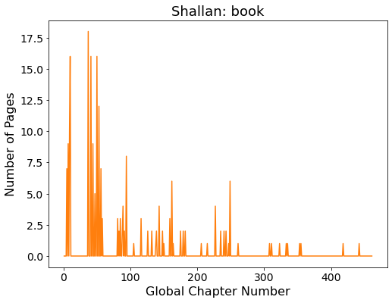
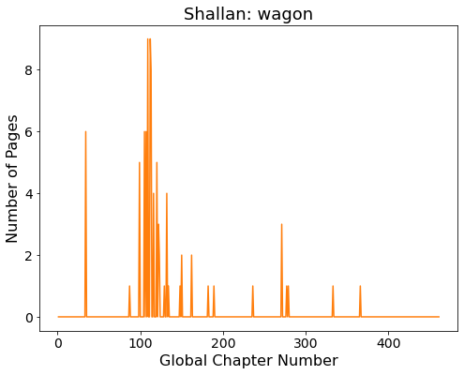
Subtopic trends

Slide 20
Adolin

Slide 21
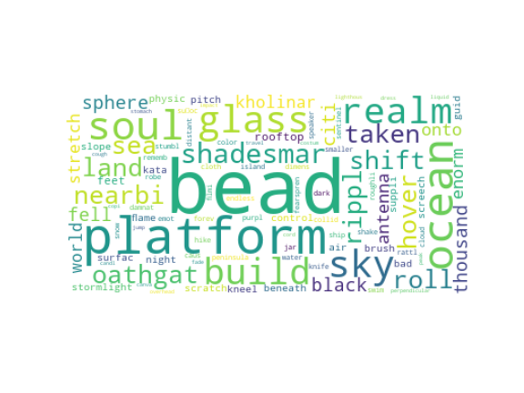
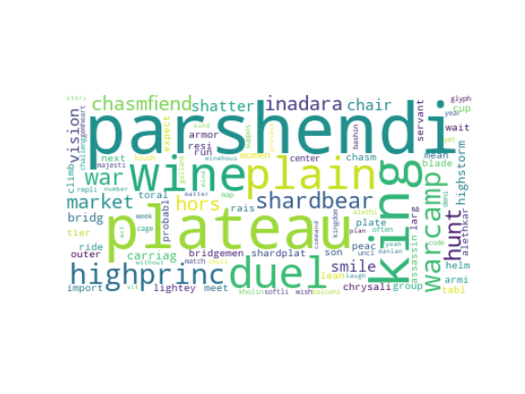
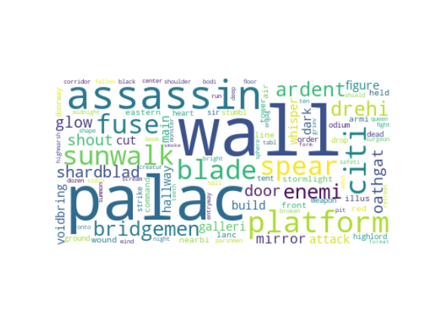
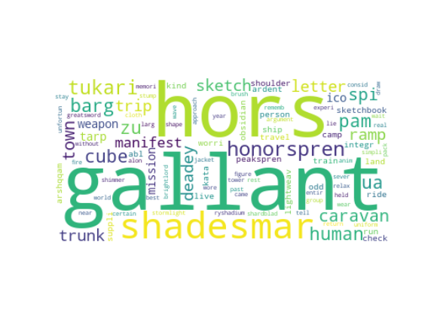
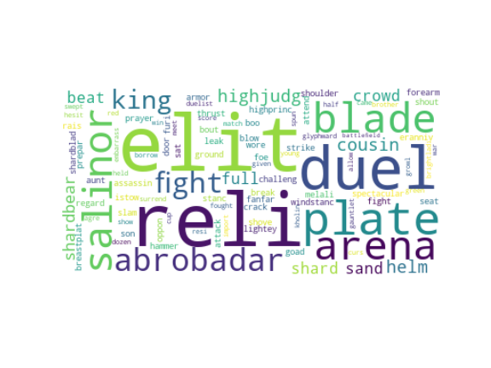
Chapter Word Clouds

Slide 22







Page
Word Clouds

Slide 23


Slide 24







Subtopic trends

Slide 25
Dalinar

Slide 26





Chapter Word Clouds

Slide 27







Page
Word Clouds

Slide 28


Slide 29







Subtopic trends

Slide 30
Kaladin

Slide 31






Chapter Word Clouds

Slide 32






Page
Word Clouds

Slide 33


Slide 34







Subtopic trends

Slide 35
Navani

Slide 36





Chapter Word Clouds

Slide 37






Page
Word Clouds

Slide 38


Slide 39







Subtopic trends

Slide 40
Szeth

Slide 41




Chapter Word Clouds

Slide 42






Page
Word Clouds

Slide 43


Slide 44







Subtopic trends

Slide 45
Venli

Slide 46





Chapter Word Clouds

Slide 47







Page
Word Clouds

Slide 48


Slide 49







Subtopic trends

Slide 50
Sentiment Trends
Ultimately didn’t work very well, apparent structure in the plots doesn’t really correlate to what’s happening in the book
Occasionally it does but sometimes it’s just flat out wrong

Slide 51


Slide 52


Slide 53


Slide 54


Slide 55


Slide 56


Slide 57


